Slide 1
Template guidance pack for distance signage to locate a defibrillator

Slide 2
AED signage guidance
Infographic showing guidance
Distance and direction to AED signage
Option 1
Option 2
Option 3
National posters
Link to research paper and recommendations
CONTENTS

Slide 3
< BACK CONTENTS
AED signage guidance
Regardless of the signage used, signs should be visible where the AED is stored and within the presumed operational radius of the AED (with a minimum of 200 m).
Signage should indicate the direction and distance to the AED.
Signage should be a sufficient size to be identifiable from a distance of at least 50 m (requiring lettering of ≈12 cm in height).
The AED cabinet should be illuminated at night, and, whenever possible, exterior signs should have supplementary lighting or at least be made of photoluminescent material.
Signage should be properly maintained; we suggest that all signs associated with the AED be inspected at the same time that the AED undergoes its routine checks (at least annually).

Slide 4
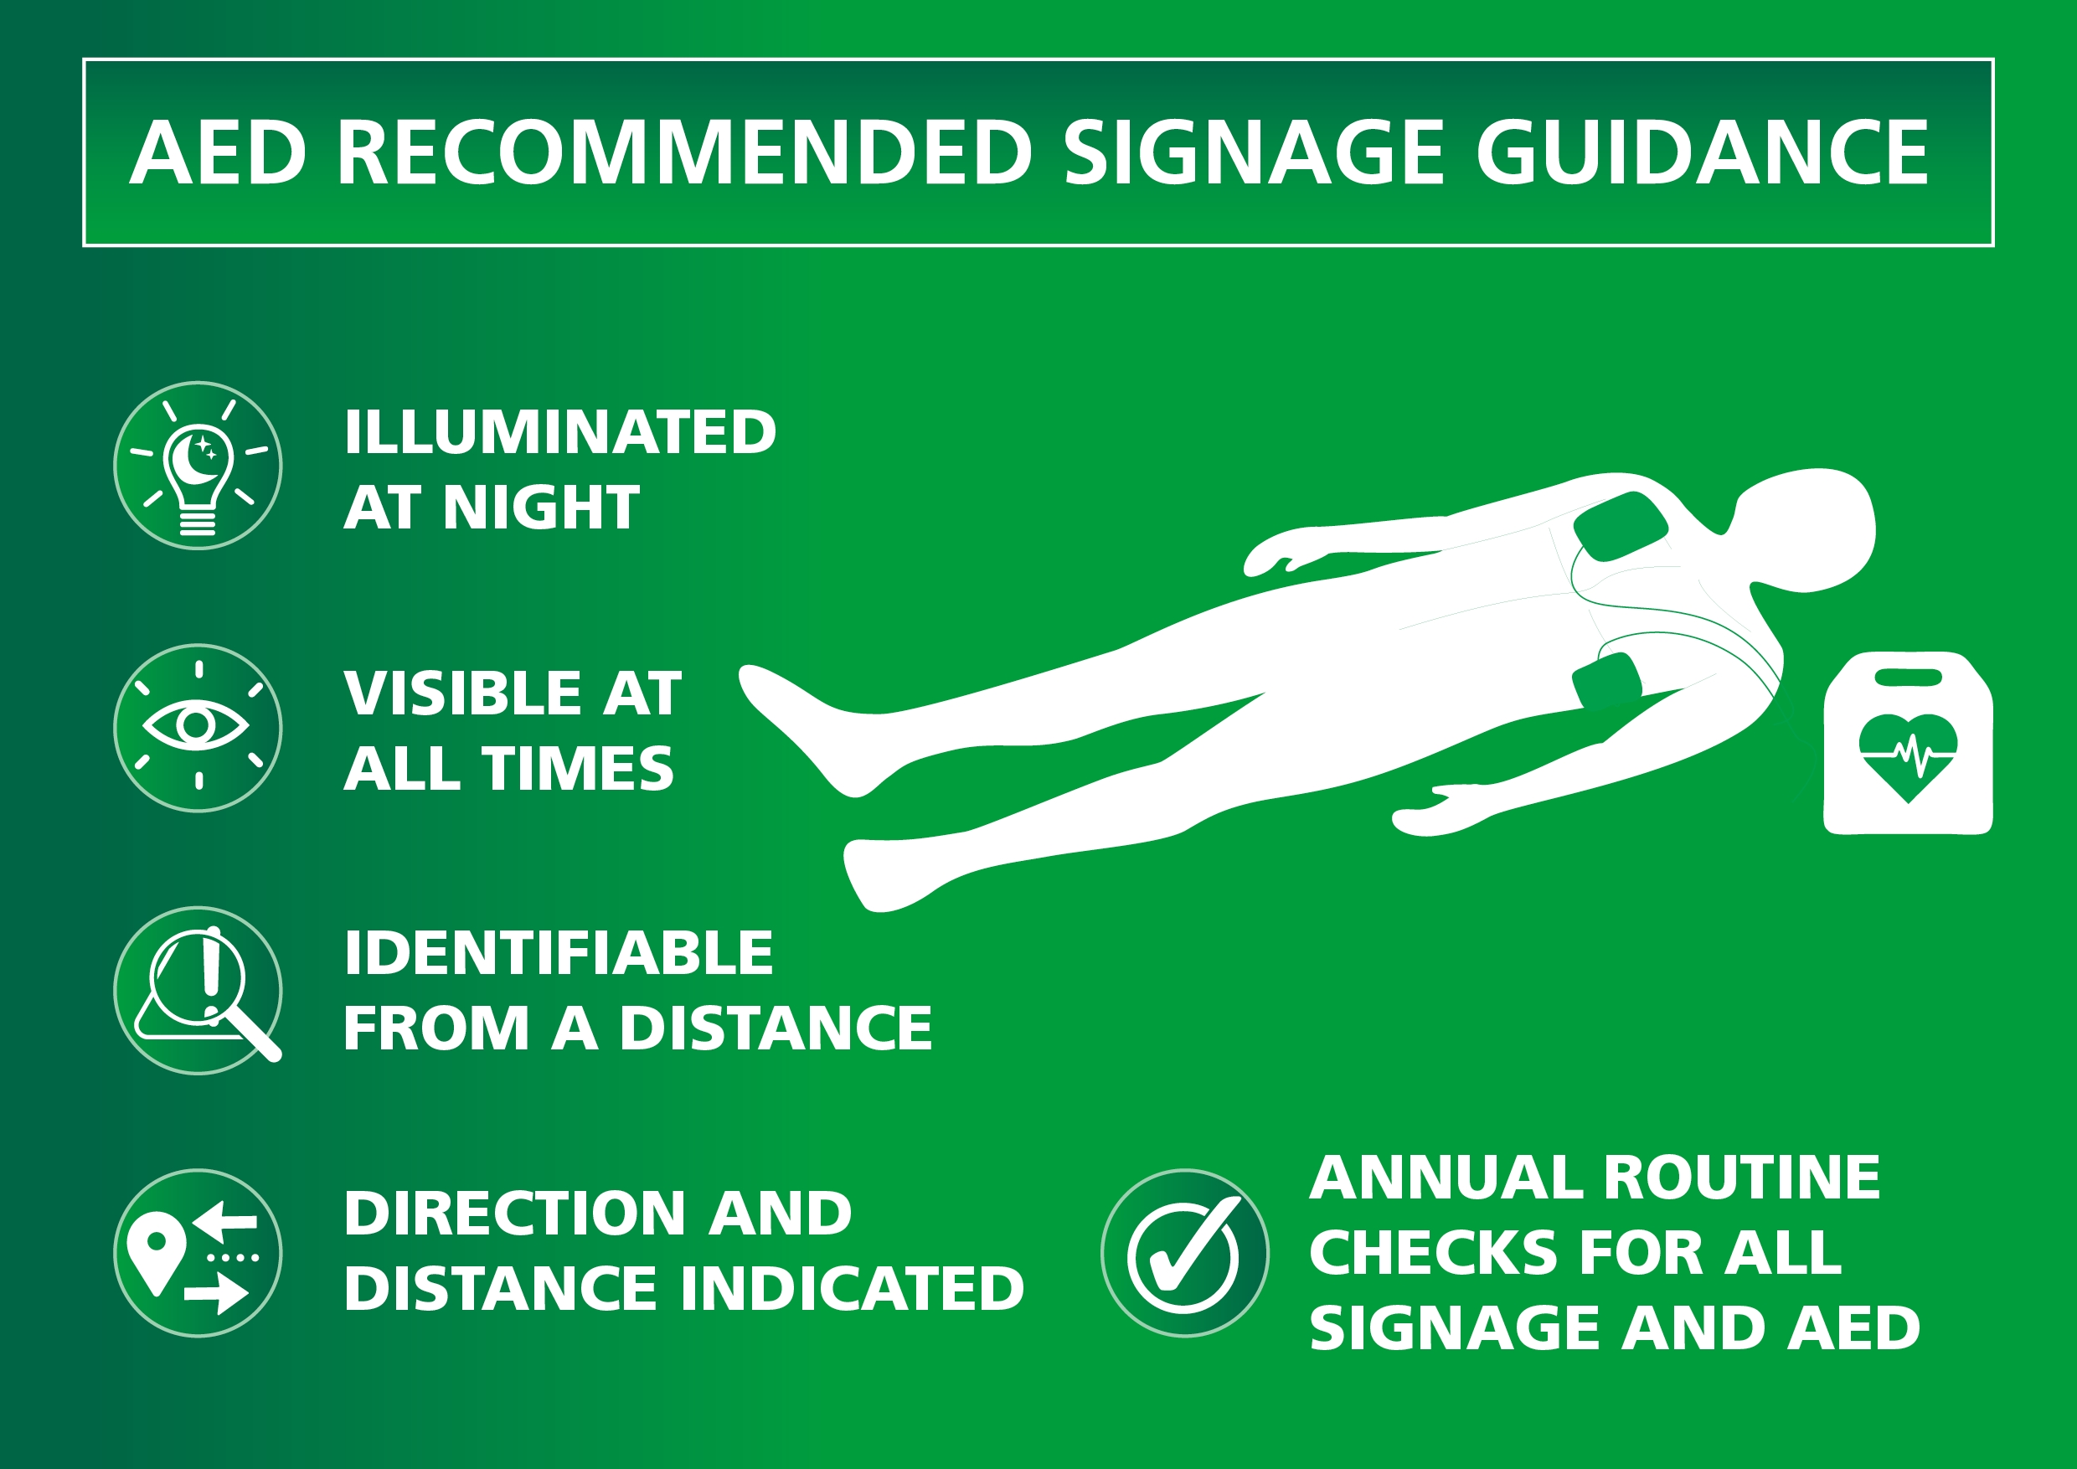
< BACK CONTENTS

Slide 5

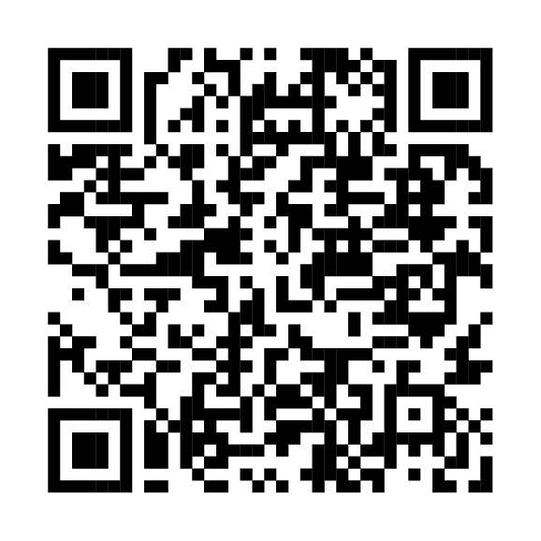
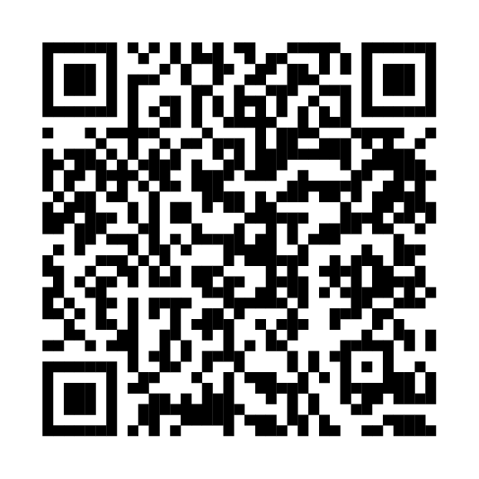
< BACK CONTENTS
Distance and direction to AED signage
Please see the following slides showing three options of signage to be displayed to show distance and direction of AED. The various sizes have appropriate font size (12 cm in height) for visibility. Combination of signs can be used depending on the size of your area.
Please print using photoluminescent material.
Please download –
Signage guidance template
Please download -
Signage artwork for print
Please share these QR codes with your local printer for professional printing, they will be able to insert the appropriate distance measurements that you provide them with.

Slide 6
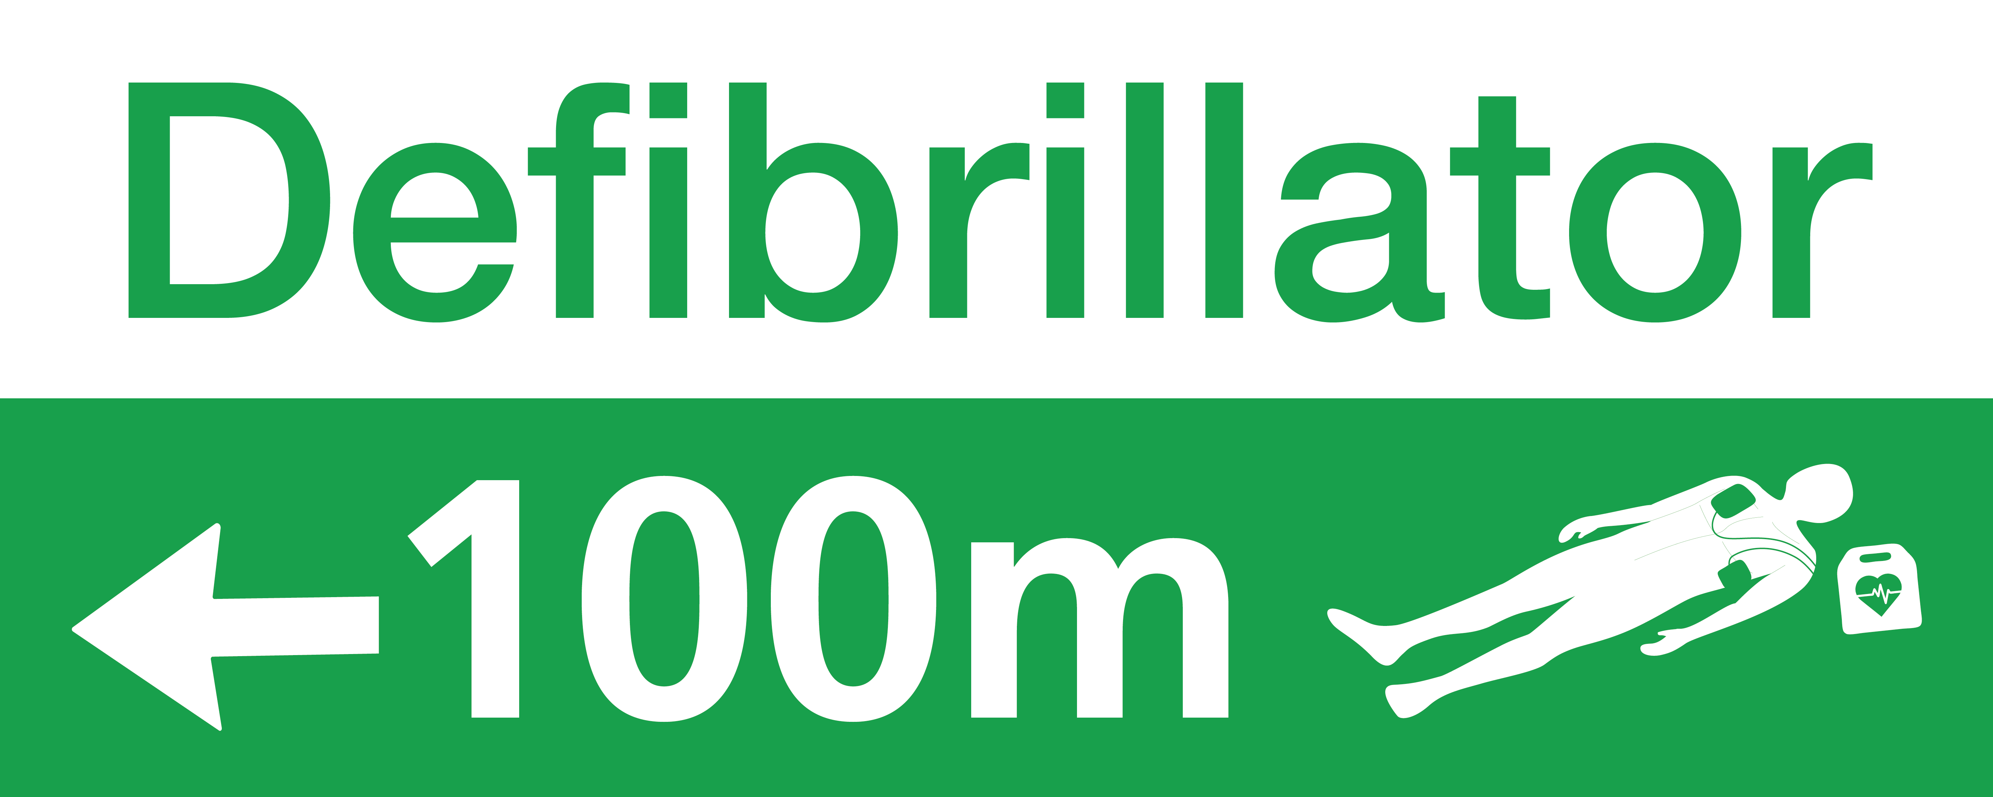
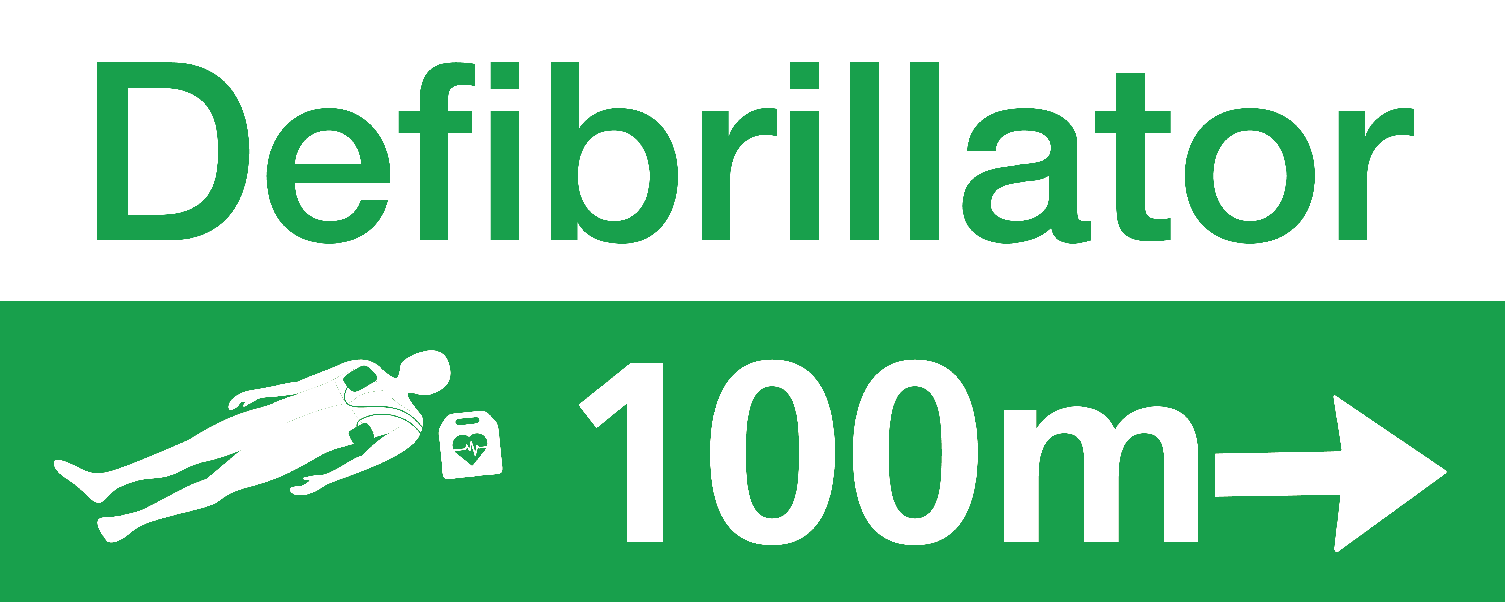
< BACK CONTENTS
Option 1
100cm
Template size
100cm wide and 40cm high
Must be printed with photoluminescent material
40cm

Slide 7


< BACK CONTENTS
Option 2
100cm
Template size
100cm wide and 20cm high
These are two separate signs that can be made as one or to be used separately depending on the location and position needed
Must be printed with photoluminescent material
20cm
100cm
20cm

Slide 8



< BACK CONTENTS
75cm
Option 3
Template size
Heart Restarter - 75cm wide and 30cm high
Distance - 75cm wide and 20cm high
These are two separate signs that can be made as one or to be used separately depending on the location and position needed.
Must be printed with photoluminescent material
30cm
75cm
20cm

Slide 9
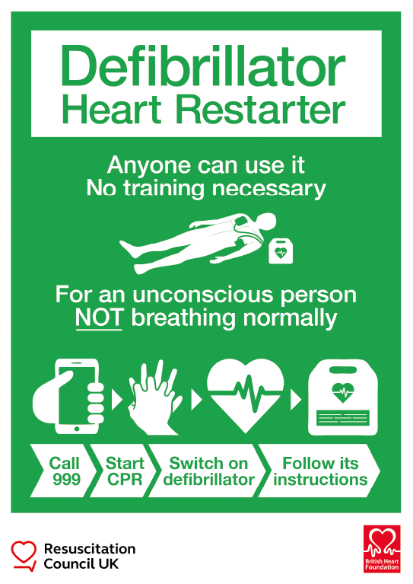
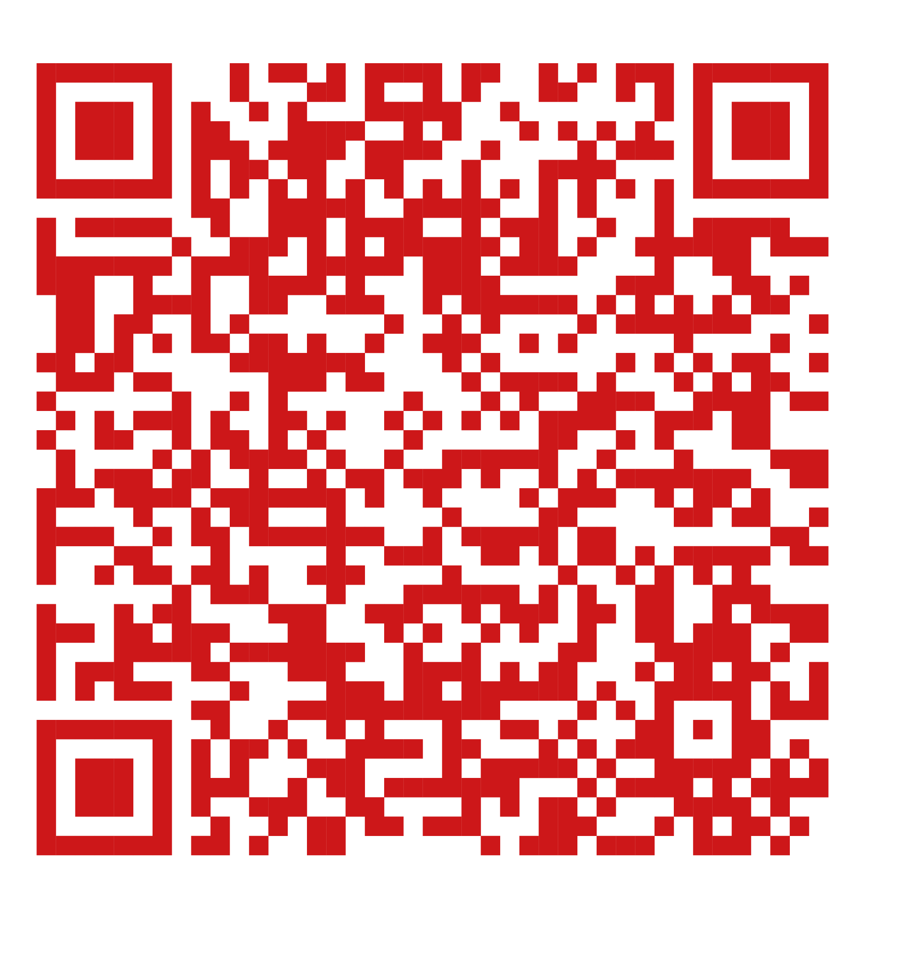
< BACK CONTENTS
Updated national posters signage to go above defibrillator
These are national posters from the Resuscitation Council UK
https://www.resus.org.uk/library/additional-guidance/guidance-defibrillators/guidance-standard-sign
Must be printed with photoluminescent material

Slide 10
< BACK CONTENTS
Research paper and recommendations
– Circulation 2022
Optimizing Outcomes After Out-of-Hospital Cardiac Arrest With Innovative Approaches to Public-Access Defibrillation: A Scientific Statement From the International Liaison Committee on Resuscitation
Brooks SC, Clegg GR, Bray J, Deakin CD, Perkins GD, Ringh M, Smith CM, Link MS, Merchant RM, Pezo-Morales J, Parr M, Morrison LJ, Wang T, Koster RW, Ong M, on behalf of the International Liaison Committee on Resuscitation.
Circulation 2022 In press. https://doi.org/10.1161/CIR.0000000000001013

Slide 11


PRODUCED BY
South Central Ambulance Service NHS Foundation Trust
scas.nhs.uk
communications@scas.nhs.uk

